Slide 1

Mini Project-II
2021-22
ONLINE VOTING SYSTEM

Slide 2
Submitted By
SACHIN(191500683)
HARISH SHARMA(191500312)
RAJU SINGH(191500631)
SHIVAM GARG(191500759)
UNDER THE SUPERVISION OF
Ms. Ruchi Talwar
(TECHNICAL TRAINER)

Slide 3
OBJECTIVES
The main objective of Online Voting System is to conduct Elections in India and World on Online Mode and make election process more clear and
user freiendly.
Online Voting System provides the online registration form for the users before voting and
makes the users to cast their vote online. The system is to be developed with high security and
user friendly.

Slide 4
Hardware and Software Requirement
        Hardware Requirements
Processor : | Intel Dual Core or more
Processor Speed : | 1 GHZ
RAM : | 1 GB(Min)
Hard Disk : | 20 GB of free space
        Software Requirements
Operating System : Window 7 and higher
Front End : HTML, CSS
Back End : SQL Server, PHP
Software : Browser, Code editor , Xampp

Slide 5
Technology Used:
SQL: SQL is a structured query language used for querying database. MySQL is an open-source relational database management system. It will help in maintaining the customers record.
CSS: CSS is cascading style sheet which is used in designing webpages and help in creativity.
PHP: Hypertext Preprocessor is a server-side scripting language designed for web development but also used as a general-purpose programming language.
HTML: Hypertext Markup Language is the standard markup language for creating web pages and web application. HTML elements are the building blocks of HTML pages. With HTML constructs, image and other objects, such as interactive form.

Slide 6
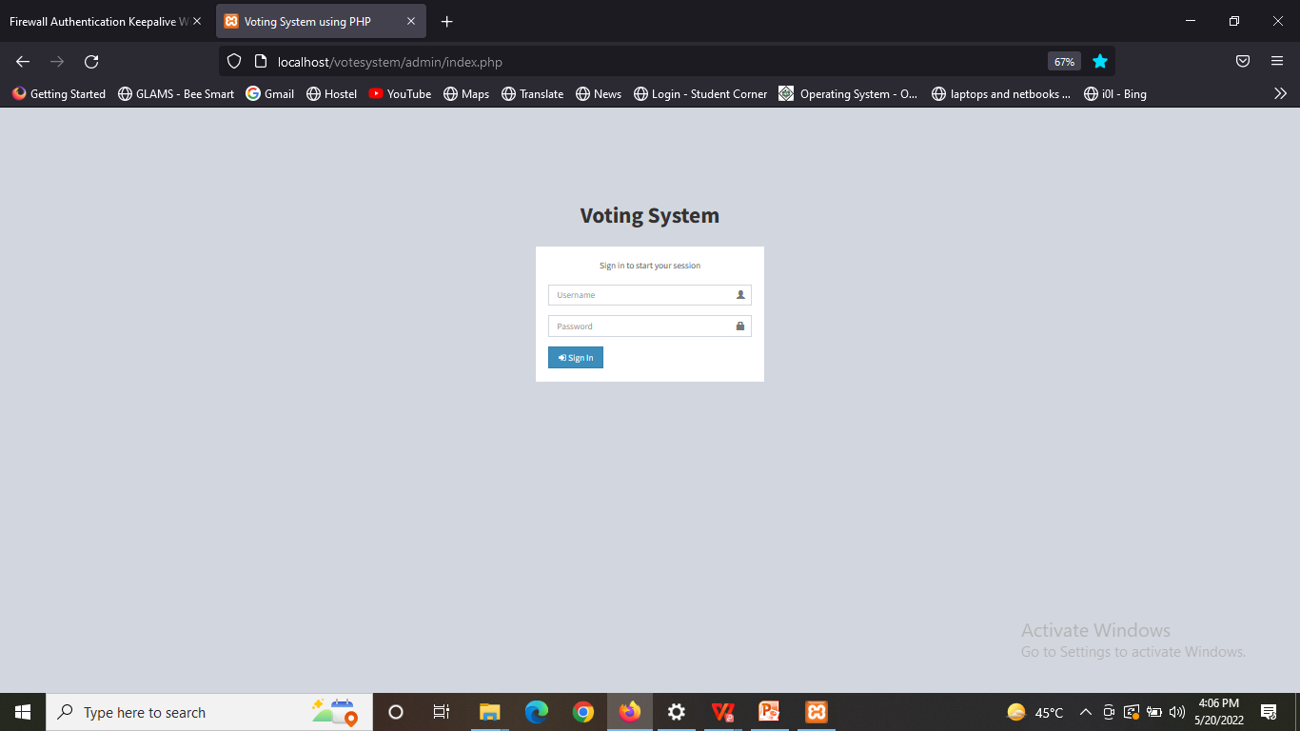
Let’s take a look at the website , Now!
This is admin login Page

Slide 7
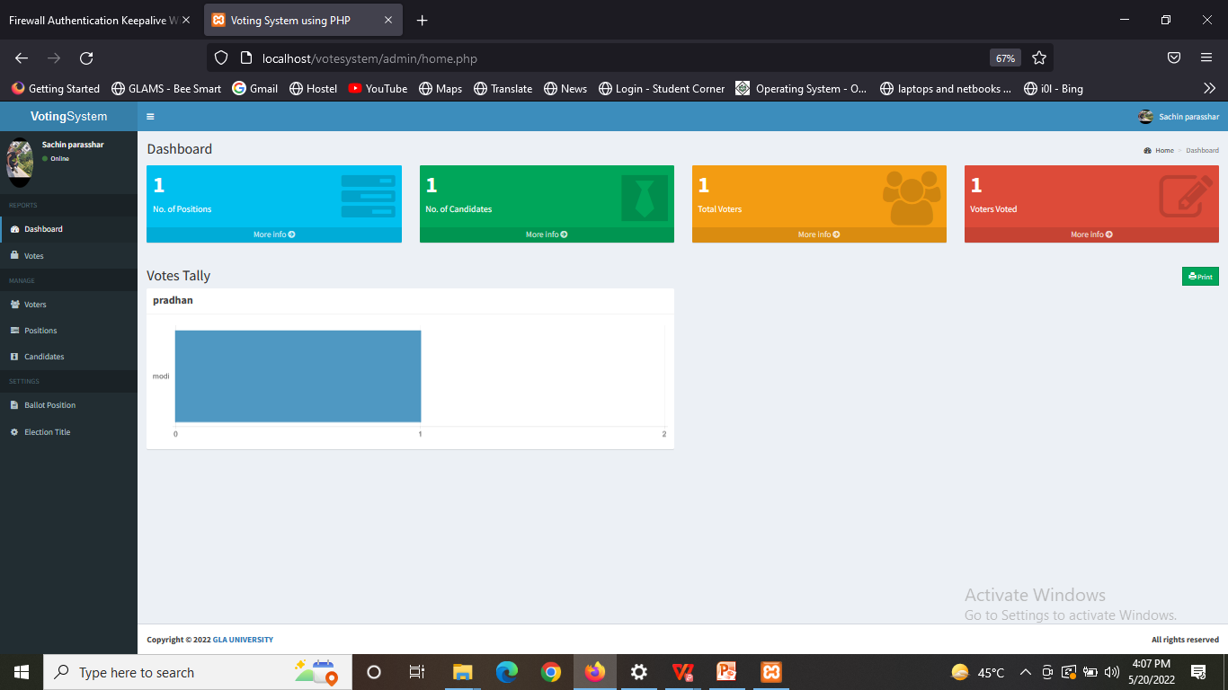
Home Page of Admin

Slide 8
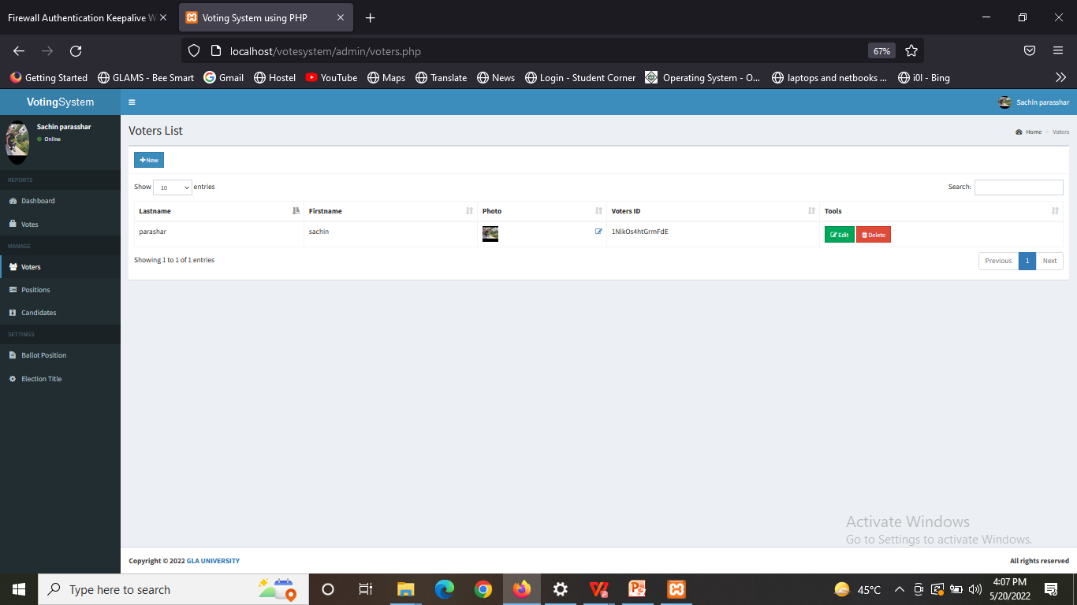
Votes page

Slide 9
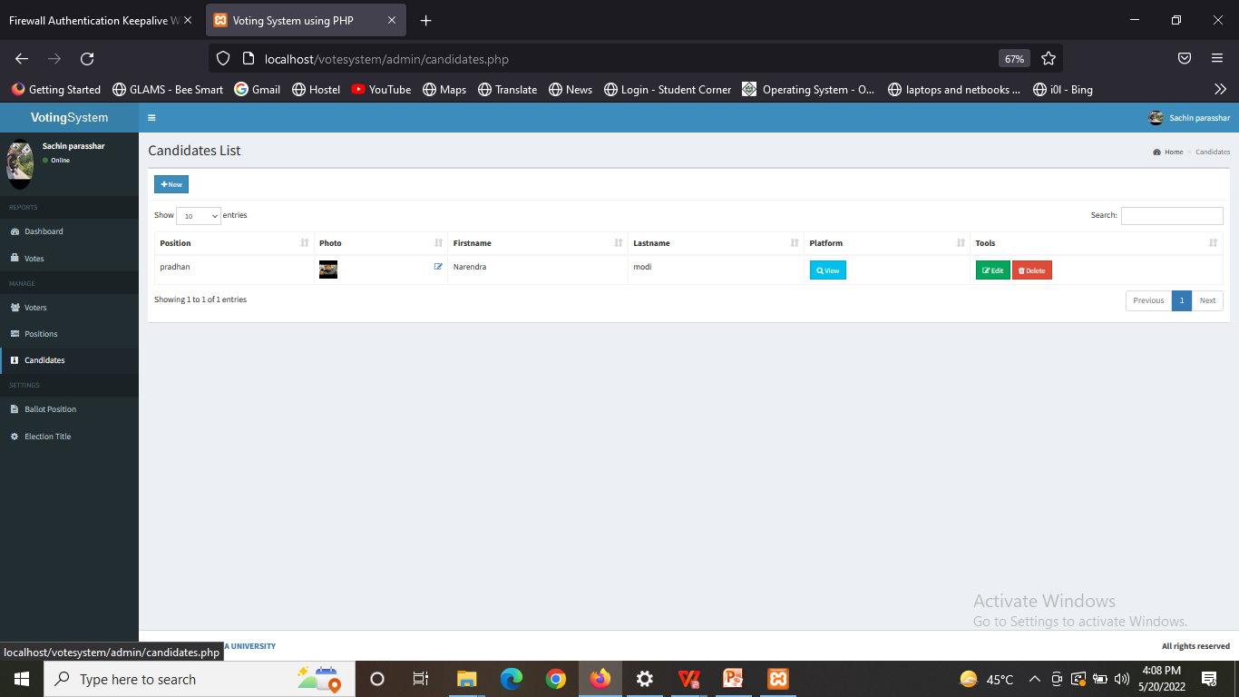
Candidates List

Slide 10
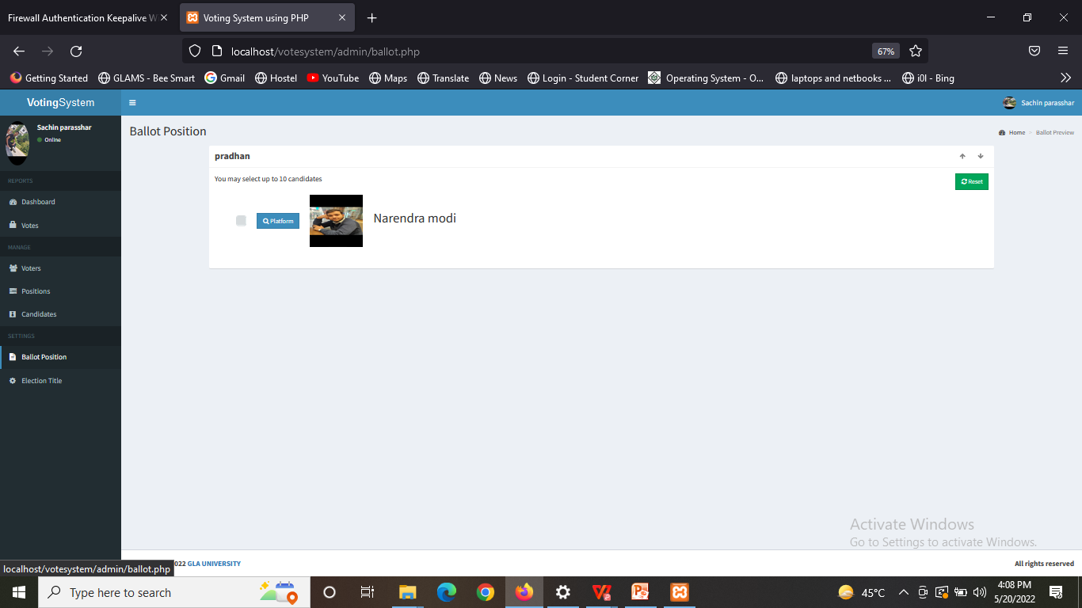
Bollot Position Page

Slide 11
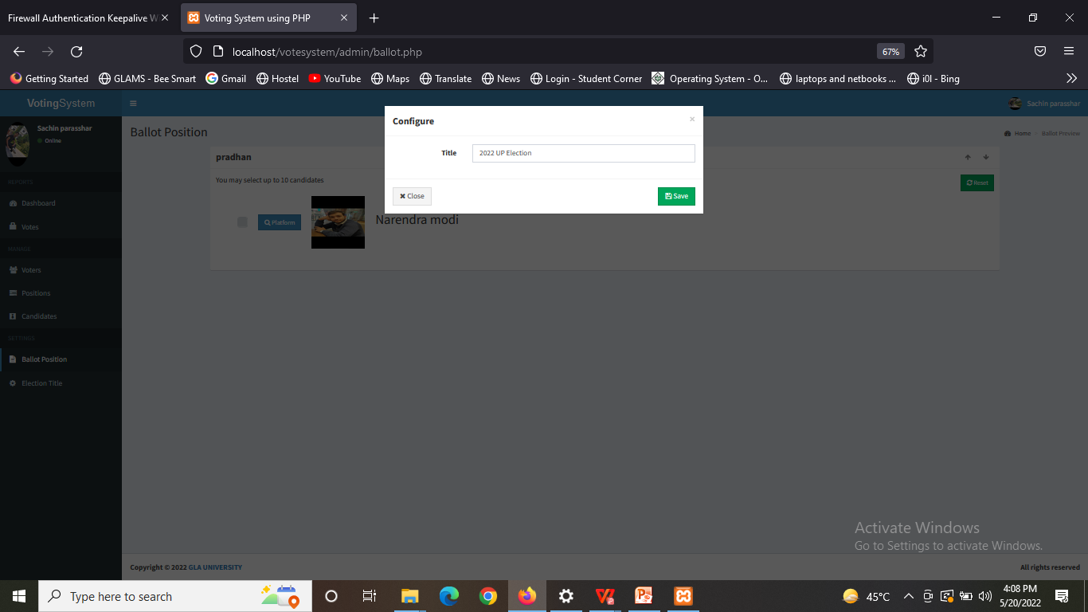
Title Page

Slide 12
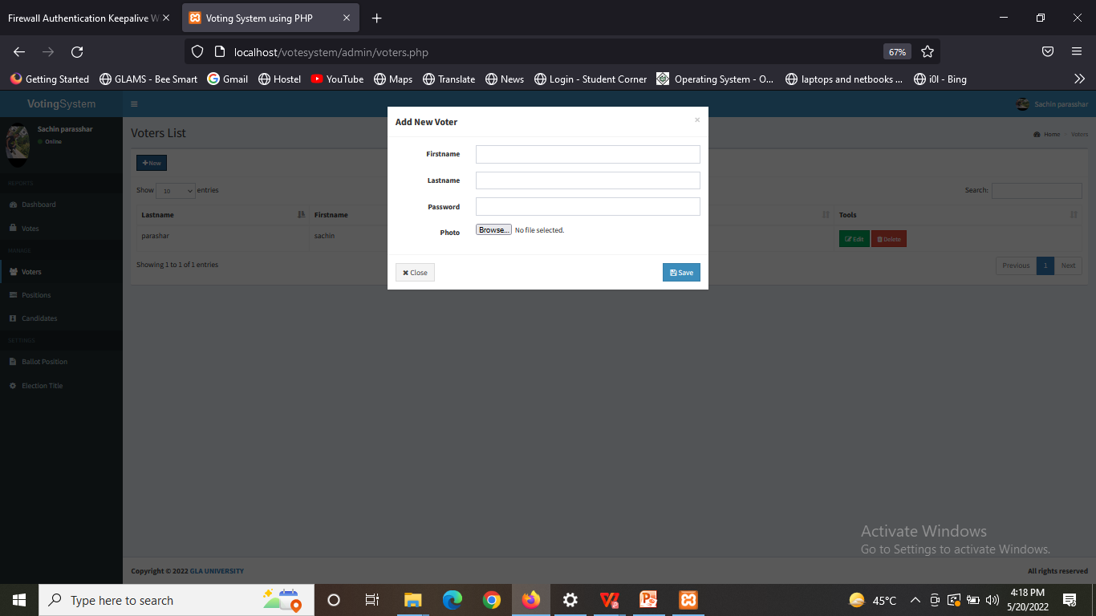
Add new User Page

Slide 13
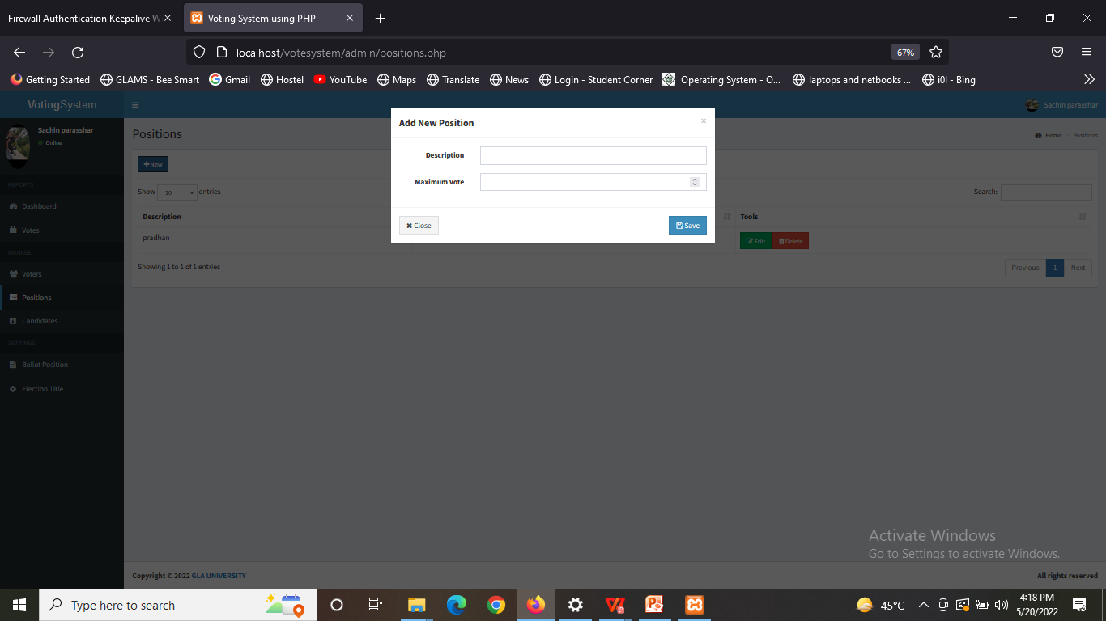
Add new position Page

Slide 14
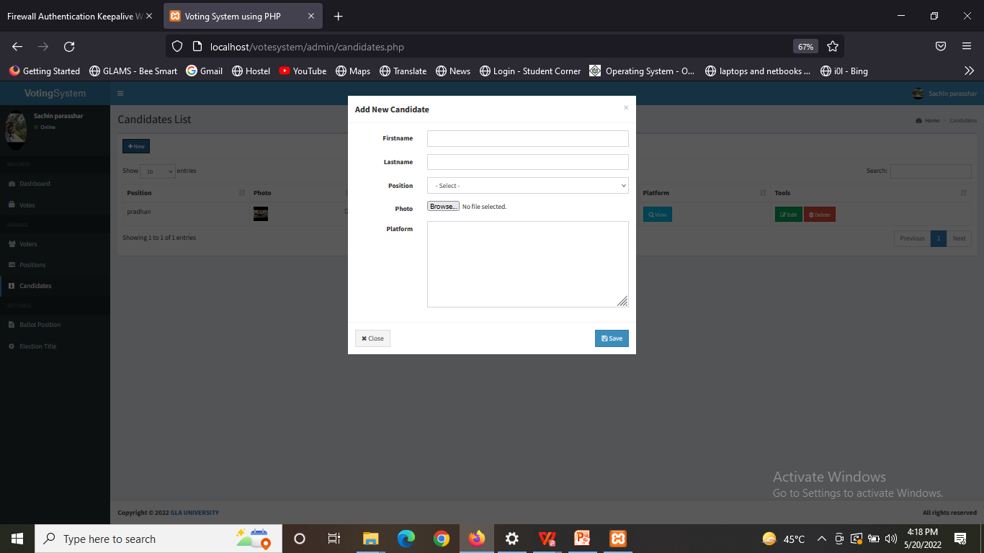
Add new candidate Page

Slide 15
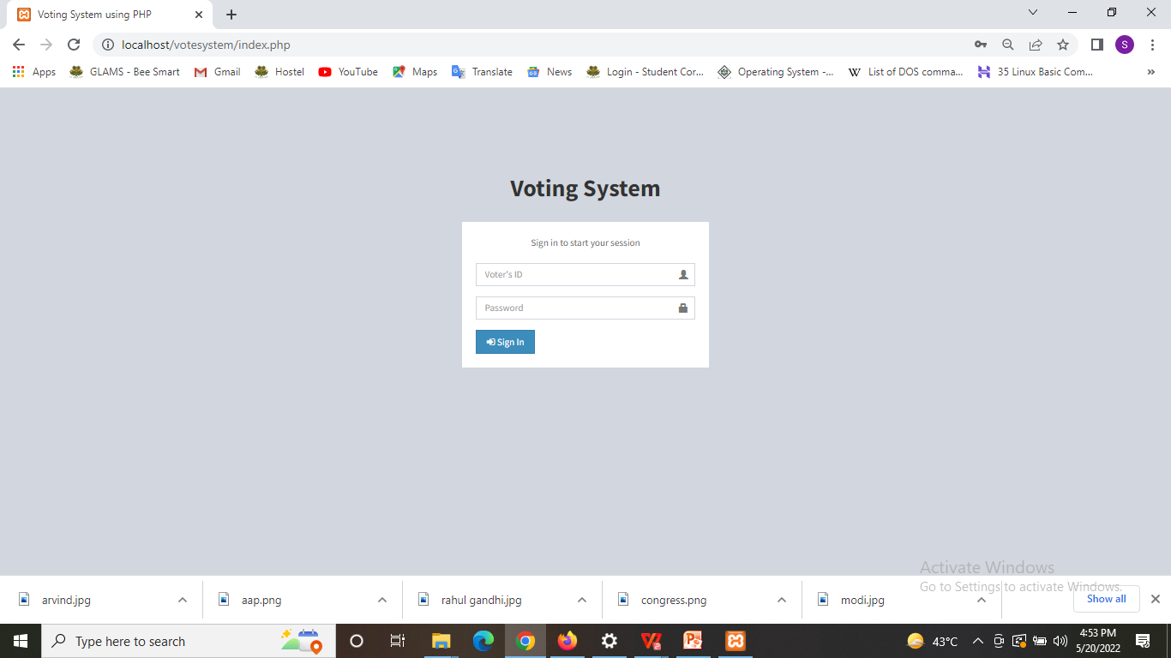
Voter Login Page

Slide 16
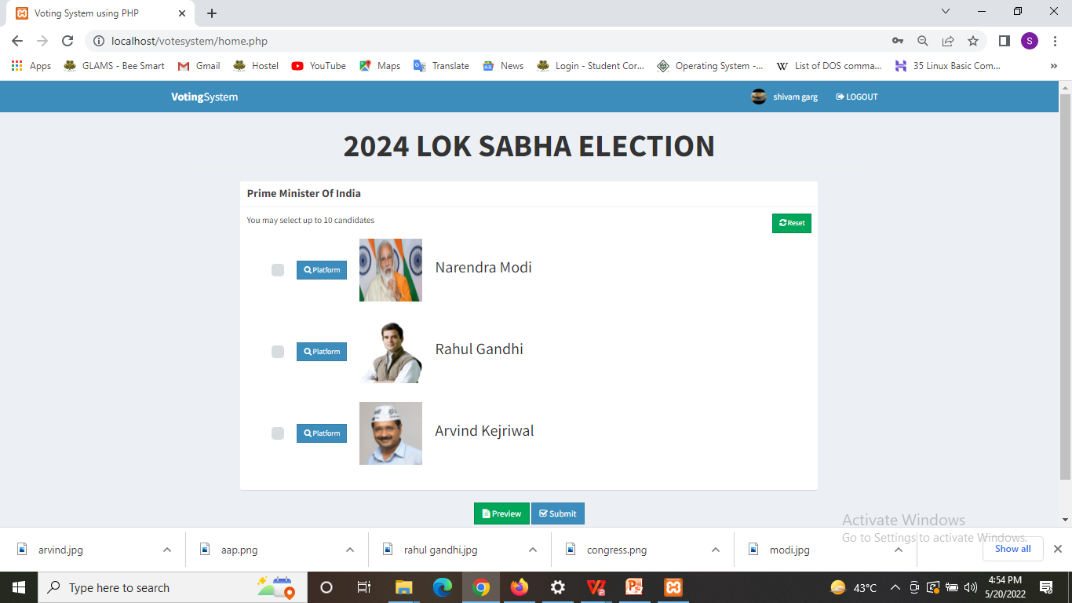
Voting Page

Slide 17
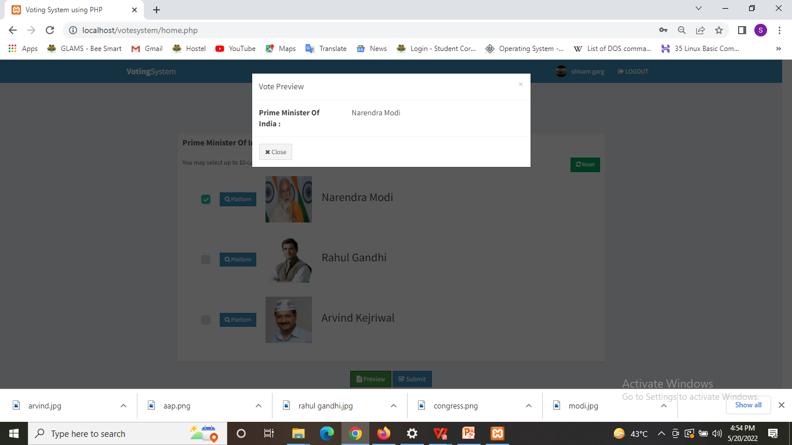
Vote Review Page

Slide 18
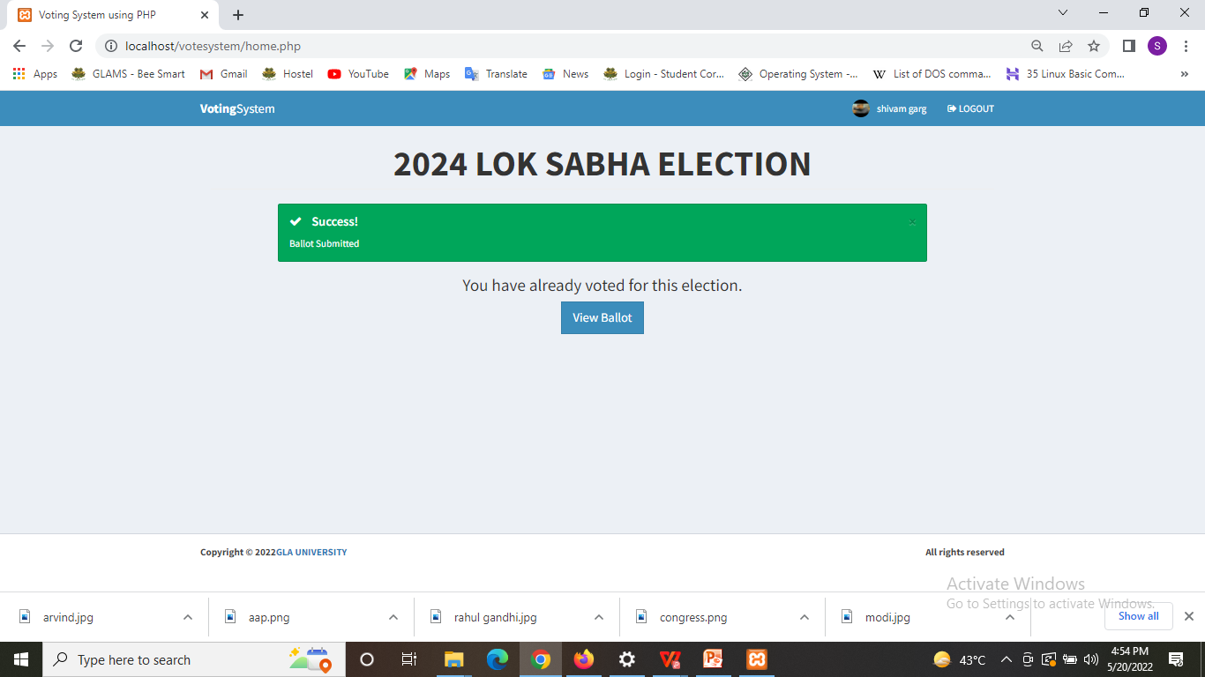
Vote confirmation page

Slide 19
About XAMPP
XAMPP is an abbreviation where X stands for Cross-Platform, A stands for Apache, M stands for MYSQL, and the Ps stand for PHP and Perl, respectively.
XAMPP helps a local host or server to test its website and clients via computers and laptops before releasing it to the main server.
It is a platform that furnishes a suitable environment to test and verify the working of projects based on Apache, Perl, MySQL database, and PHP through the system of the host itself.

Slide 20
Future Scope
First we want to conduct local election like
election of Universities and local bodies
by our portal
And after it will take our portal to district level after it state level last to National level.

Slide 21
CONCLUSION
This was the first considerably large and important project undertaken by us during our B-TECH course. Tt was a wonderful experience developing Online Voting system.
We have learnt and tried to develop a project that can be useful for government to conduct elections in less cost and very fast.
Online Voting System provides the online registration form for the users before voting and makes the users to cast their vote online. The system is to be developed with high security and user friendly.
Fast and easy way of conducting Election. Voters can view background of each Candidate. Candidate can present themselves against voters. Admin can verify the documents and details of Candidate . System Generated Unique ID and Password gives more Secure Logins. Result will be out after 2 Hours of Election.

